Slide 1
Corona-Spread
By Vamsi Krishna Navuluri, Jim Comas, Meliha Osmanovic and Aukje Rijpkema
March 4th, 2020
Washington University Data Analytics Boot Camp
Notes:
10 sec

Slide 2
Functionality of the Corona-Spread Application
Provide user with the most current data and world map related to the Corona-virus outbreak
Allow user to see spread over time visually on world map with the option to see a specific date using the slider
Allow user to see the growth over time in a bar chart with the option to filter by country
Allow user to be able to query the latest news and the news facts
Allow user to filter news and facts by date using the slider
Notes:
About 1 min 10 sec.

Slide 3
Full Stack Application - BACKEND
PostgreSQL Database:
2 tables
China - daily_stats > 1200 records
World - daily_stats_world > 6300 records
Python scripts:
Extraction and Transformation 2 data sources:
Repo by Walter Stanish from Zhuhai https://github.com/globalcitizen/2019-wuhan-coronavirus-data
Repo by John Hopkins University: https://github.com/CSSEGISandData/COVID-19
Loading - save data to database
Merging data files with choropleth geojson files for World/China to create 1 geojson per day
Scraping news data
Scraping facts
FLASK_API (app.py):
Python script to retrieve data from database and pass to html/js
Notes:
2 min

Slide 4
Full Stack Application - FRONTEND
HTML:
3 page HTML website using plotly, leaflet, d3 and bootstrap libraries
JAVASCRIPT:
8 javascripts to
2 - Map and Plot World Data - world.js and world_bar.js
2 - Map and Plot China Data - china.js and china_bar.js
2 - Create Slider functionality - slider_china.js and slider_world.js
2 - Render and display News articles and Facts - render_news.js and cnnData.js
CSS:
Formating of slider and other html elements
Heroku app: corona-spread.herokuapp.com
Notes:
45 sec

Slide 5
Full Stack Application - Interactive functions
Interactive functionality
Date Slider on every page
Dropdown box with Countries for the bar chart
Show spread button on the World page to animate spread
Dropdown boxes to filter the news by date / news source
Facts toggle button for all or filtered new facts
Heroku app: corona-spread.herokuapp.com
Notes:
34 sec.

Slide 6
Corona Spread - World Wide - Spread
Notes:
30 sec.

Slide 7
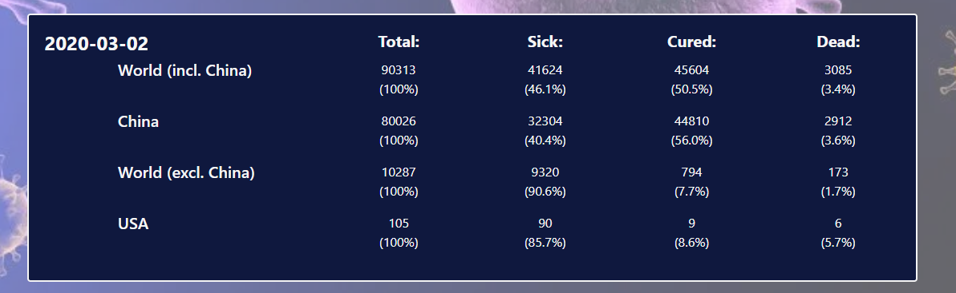
Corona Spread - High level summary
Notes:
10 sec

Slide 8
Corona Spread - World Wide - Chart and Top 10
Notes:
25 sec.

Slide 9
CoronaVirus Outbreak Timeline Fast Facts
Website:
https://www.cnn.com/2020/02/06/health/wuhan-coronavirus-timeline-fast-facts/index.html
Timeline from December 31, 2019 to February 26, 2019

Slide 10
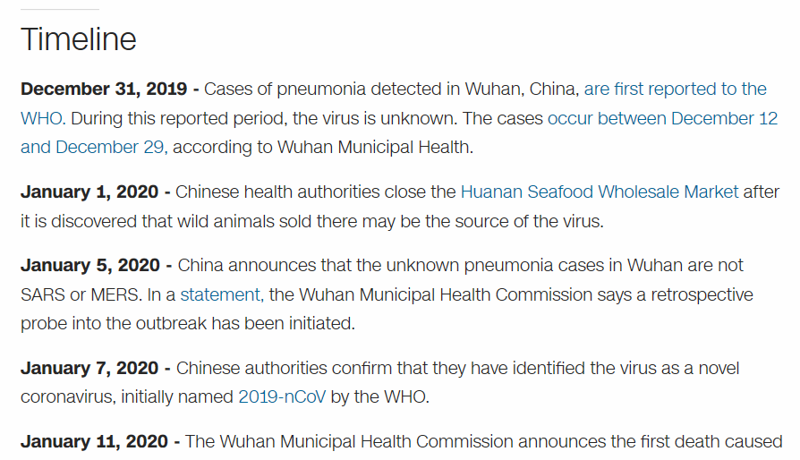
Timeline

Slide 11
Web Scraping
Web Scraping of the CNN website was done in Jupyter notebook.
Some dates had multiple facts, so data cleaned.
JavaScript file was created for the data.
Render function was then created to call the data.

Slide 12
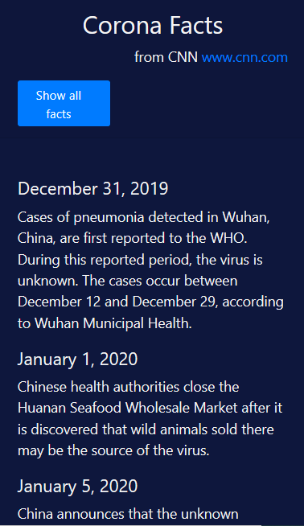
Difficulties experience:
When data was scraped the date format had an extra space.
Timeline formatting was too big.

Slide 13
Corona Spread - World Slider
The slider section allows the user to easily jump to a specific day.

Slide 14
Corona News
Corona News is derived from the following websites, ABC News, Al Jazeera English, Associated Press, Bloomberg, Breitbart News, Business Insider, CBS News, CNBC, CNN, Fortune, Fox News, Medical News Today, MSNBC< National Geographic, National Review, NBC News, New Scientist, Newsweek, Politico, Reuters, The Globe and Mail, The Hill, The Huffington Post, The Wall Street Journal,The Washington Post.
Date starts from January 21, 2020 and defaults the last available date and interacts with the slider as well.
Allows users to select date and news source from dropdown.

Slide 15
Conclusion: Corona-Spread application
Tells the story of the spread of the Corona virus
through an interactive map
through an interactive bar chart
through and interactive slider
through interactive news facts
through interactive news dates and sources
Is a full stack application using:
Python
FLASK API
HTML/CSS
Javascript
PostgreSQL database
Uses webscraping, d3.js, leaflet.js and plotly.js
Includes a slider.js library that was customized to meet our needs
Uses a multitude of views to look at data, maps, facts and news related to the Corona Virus
Is available on HEROKU at: https://corona-spread.herokuapp.com/

